Slide 1
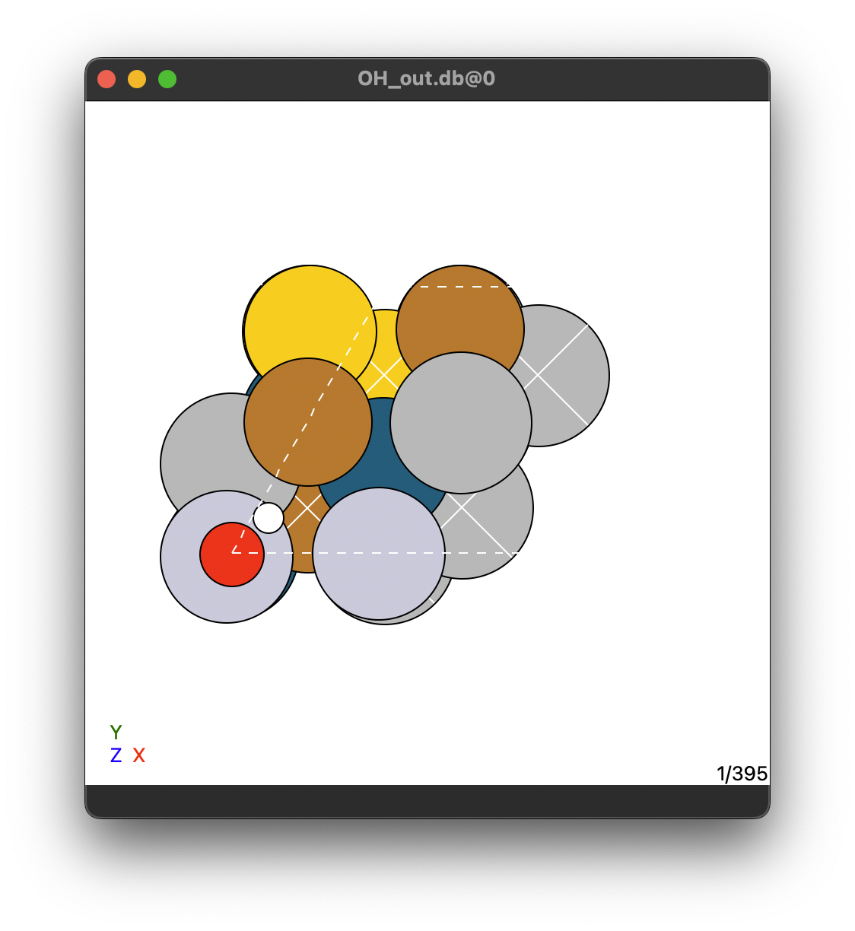
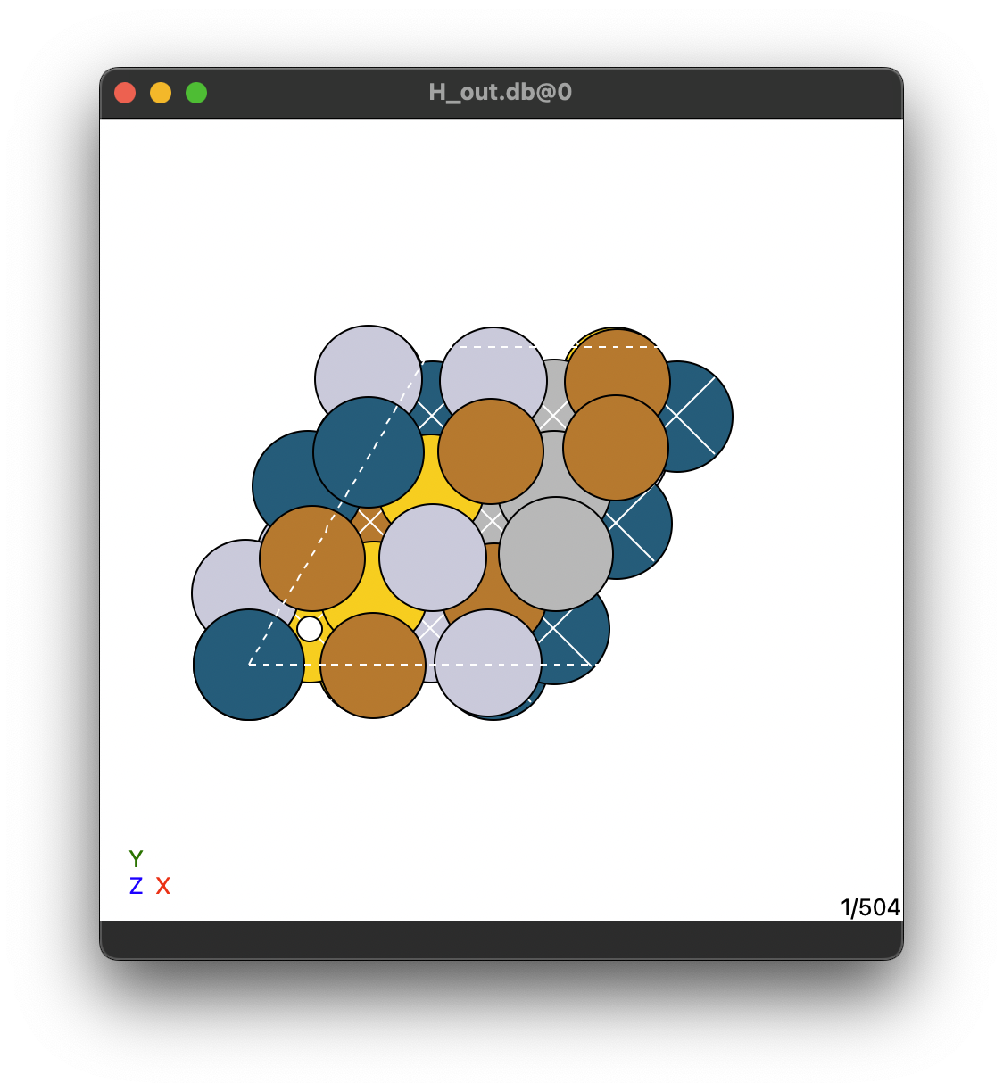
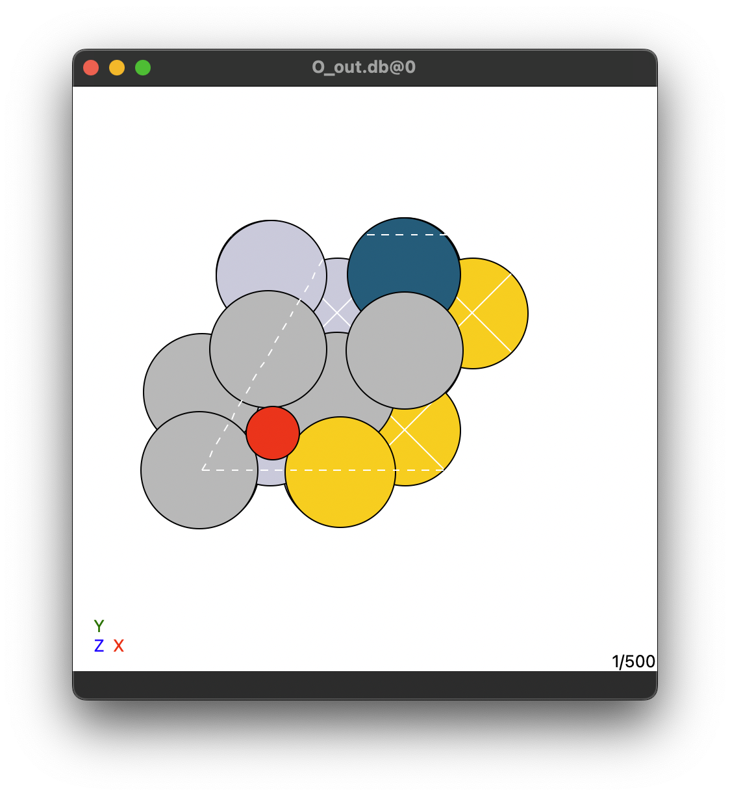
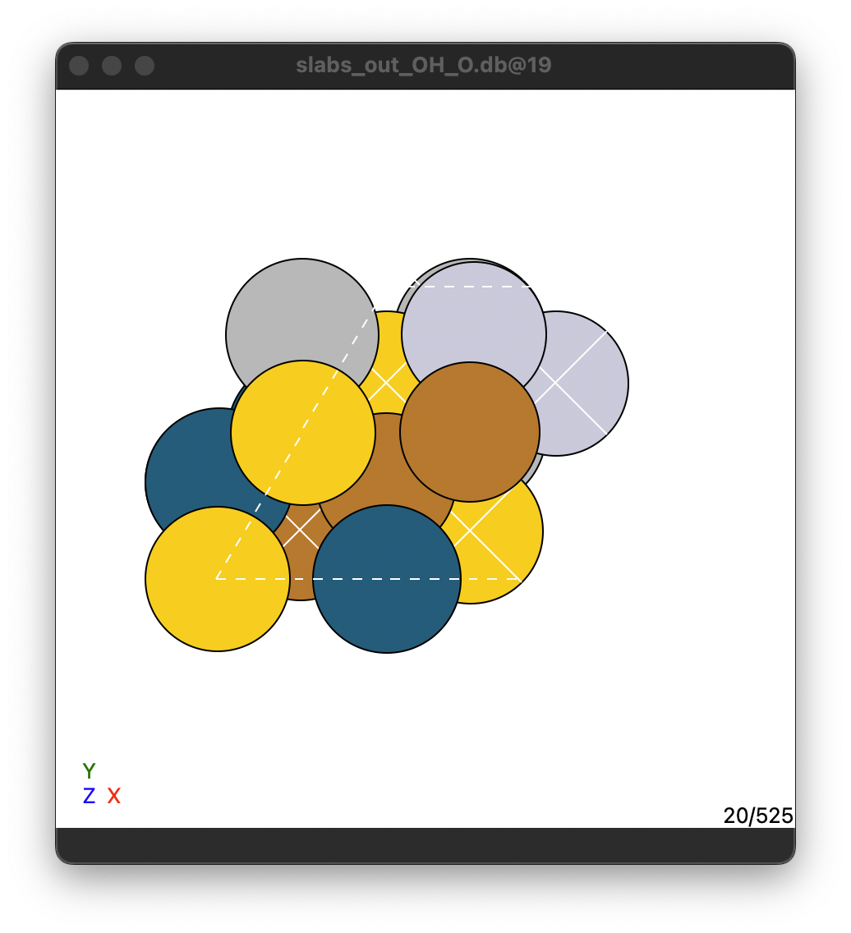
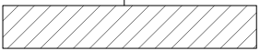
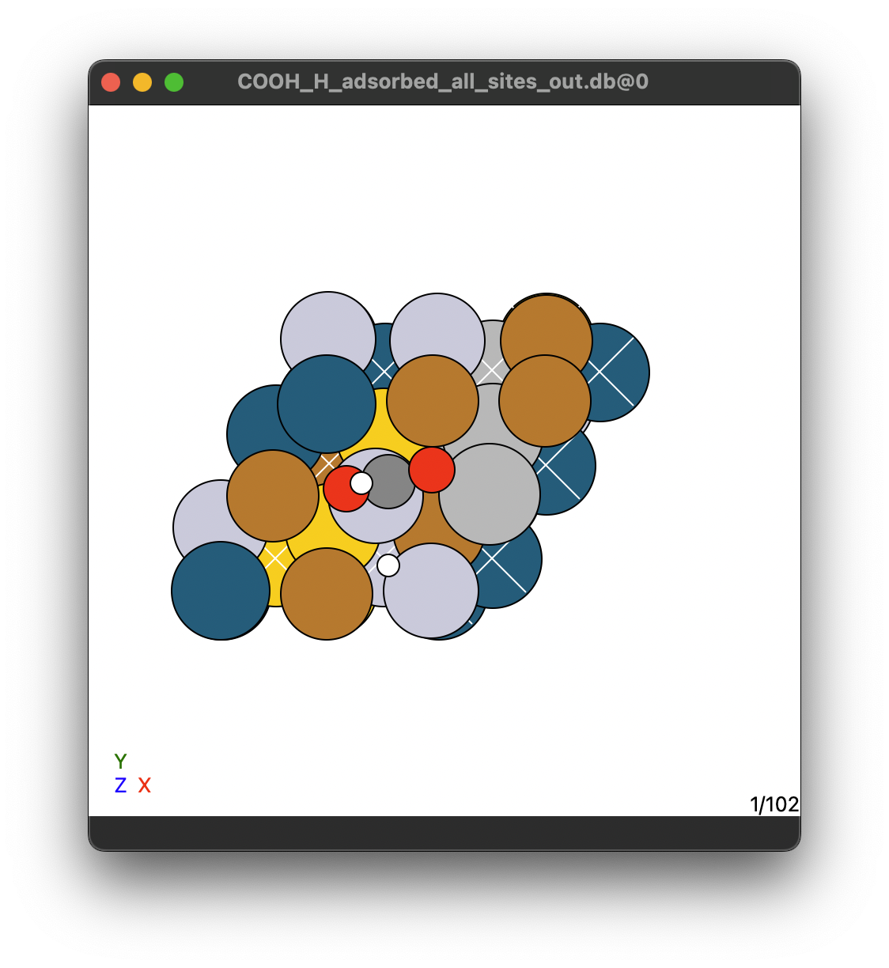
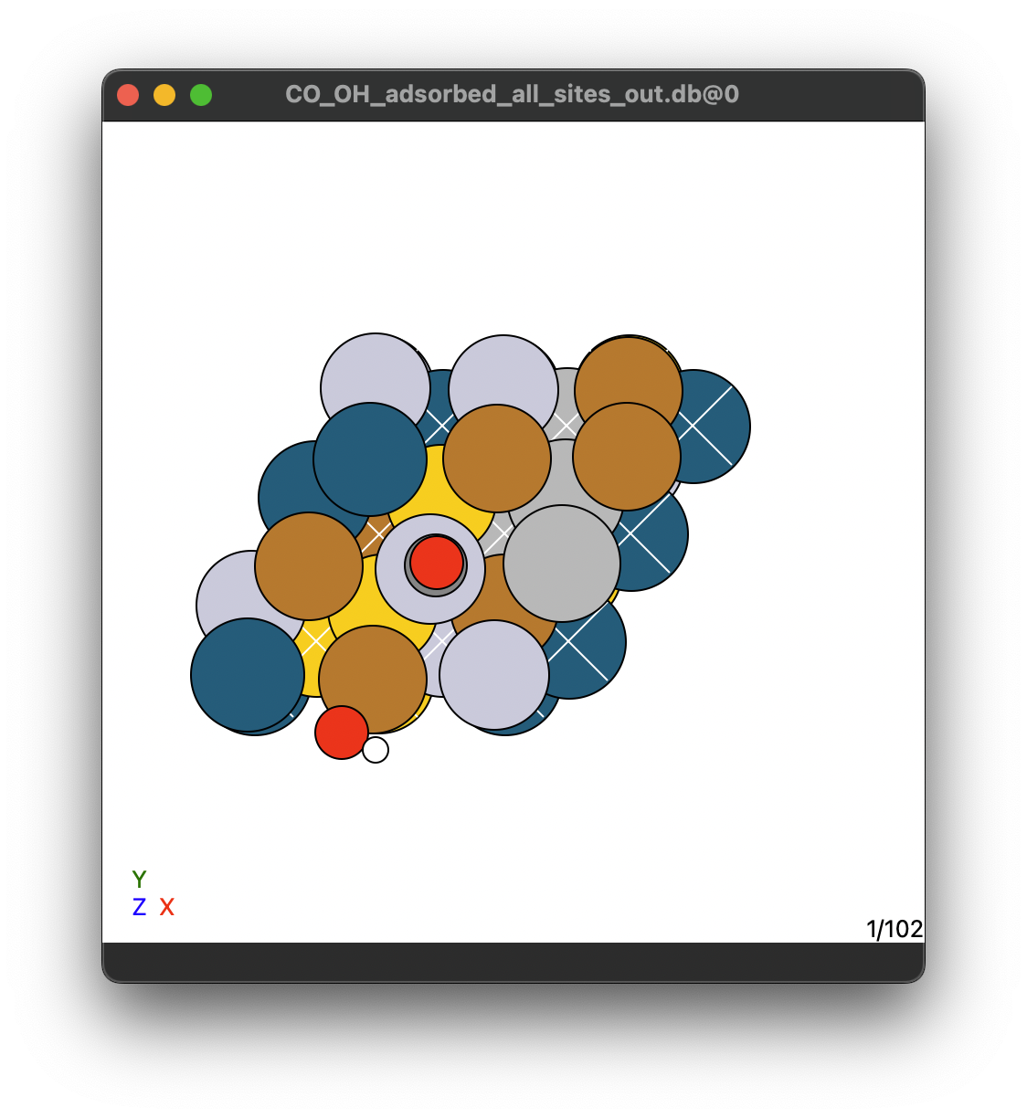
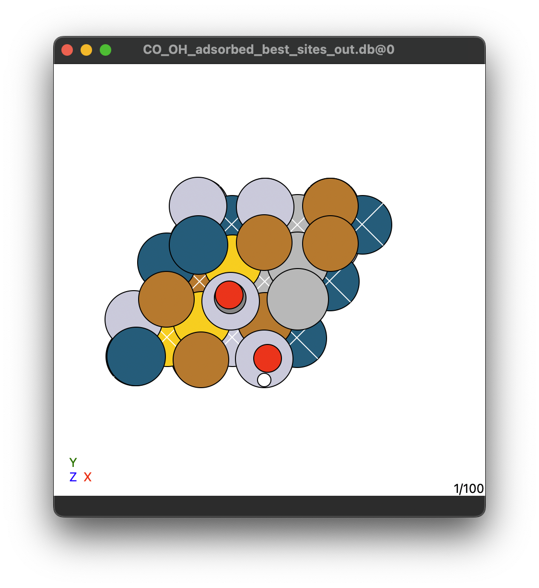
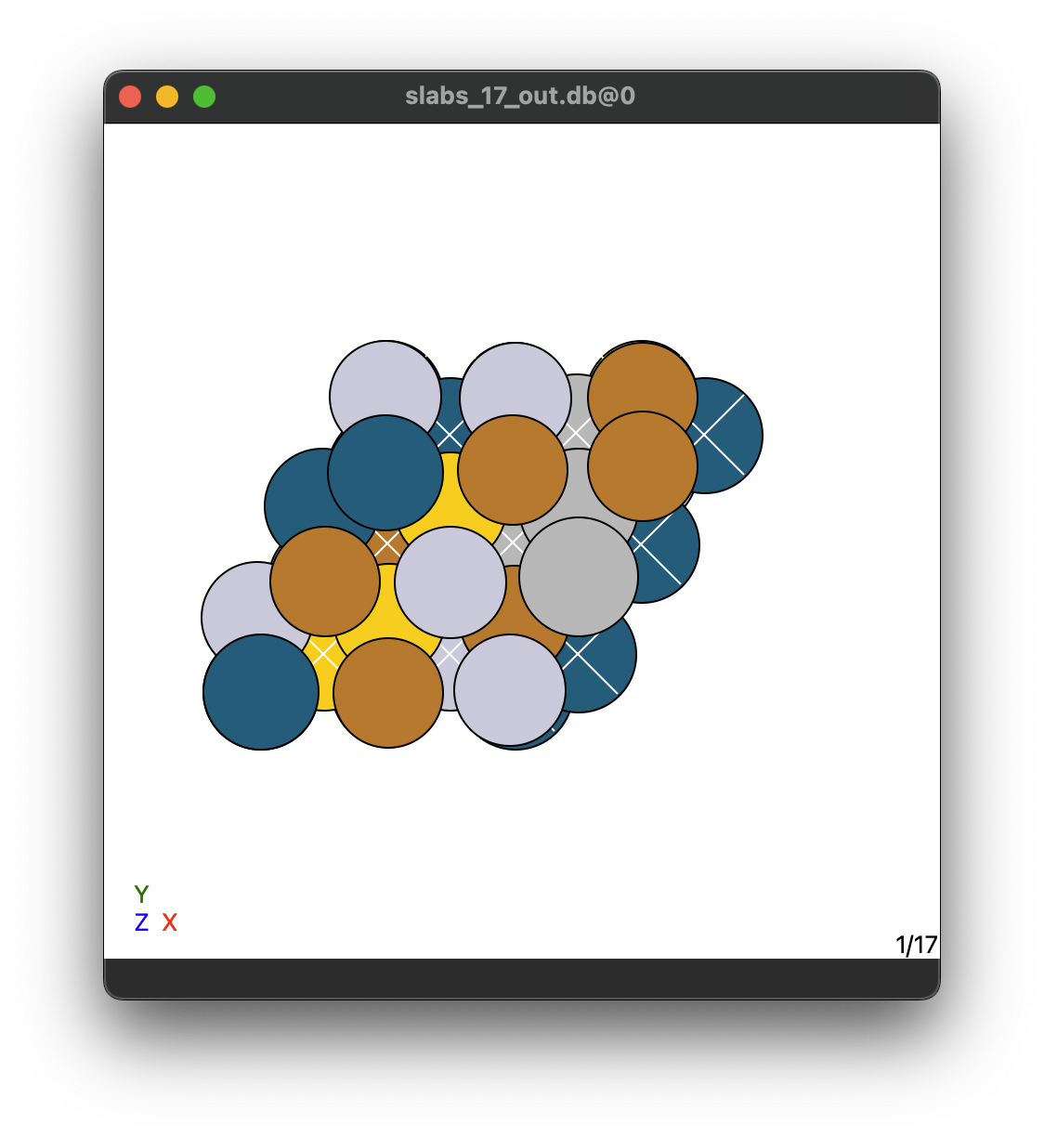
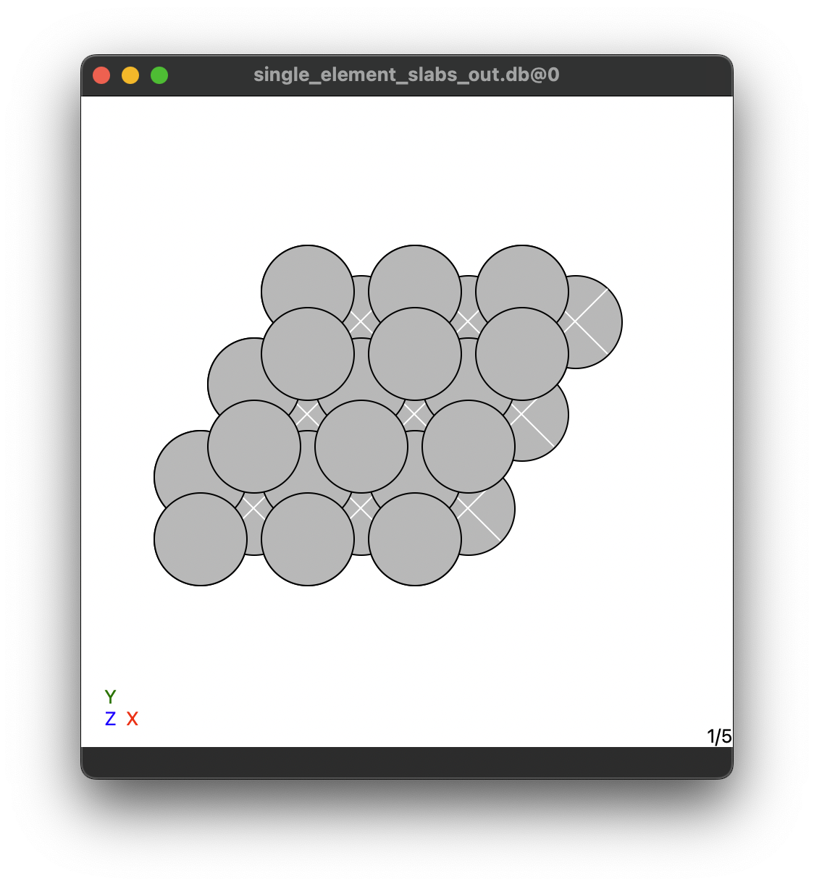
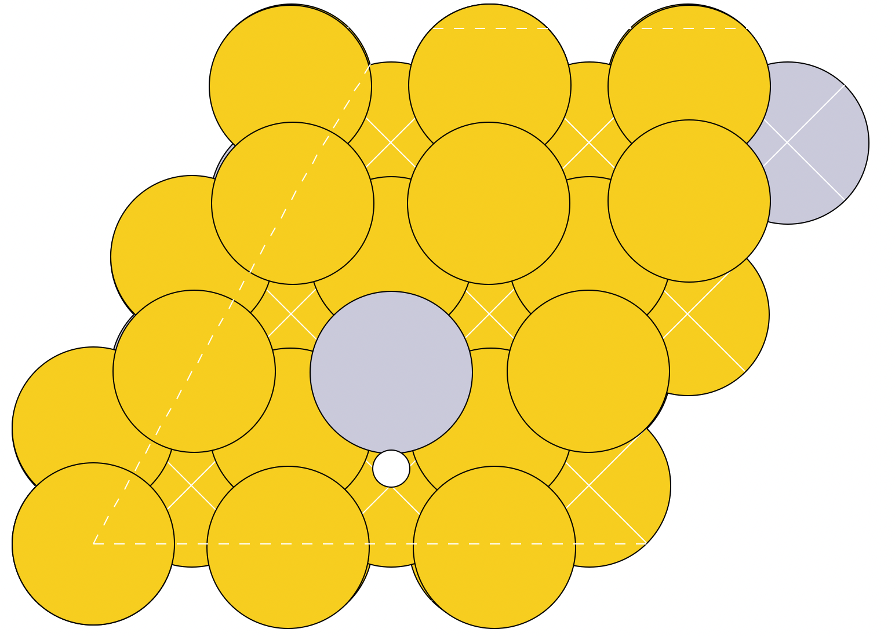
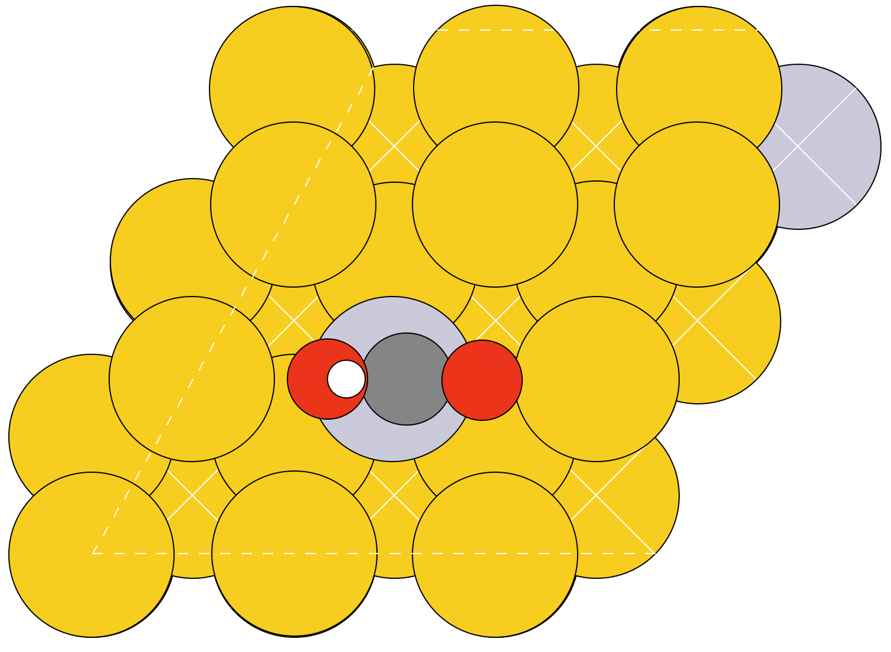
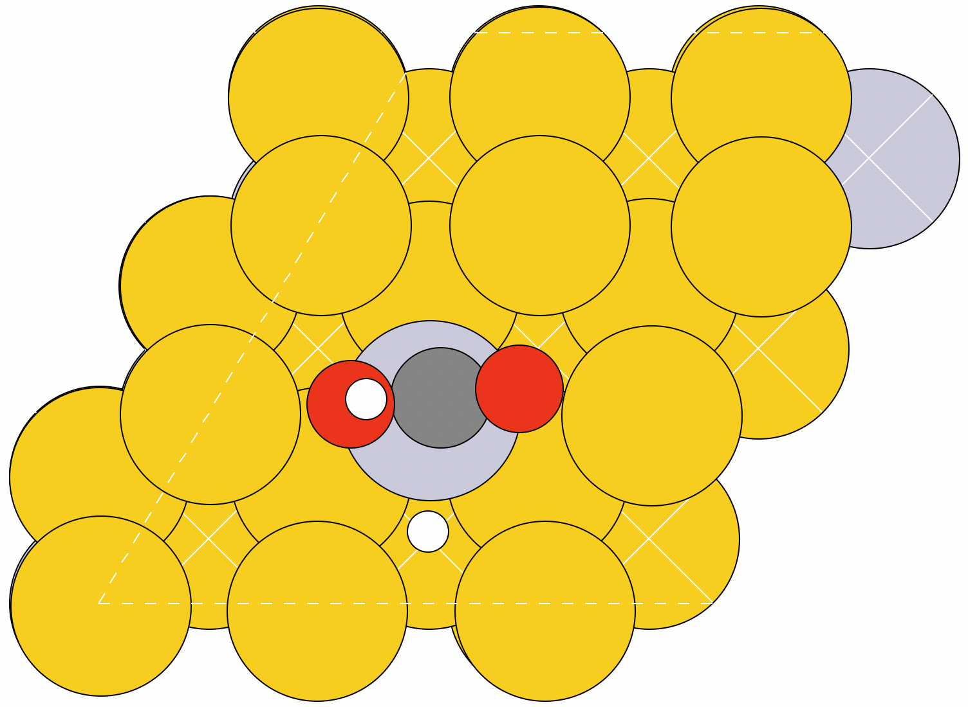
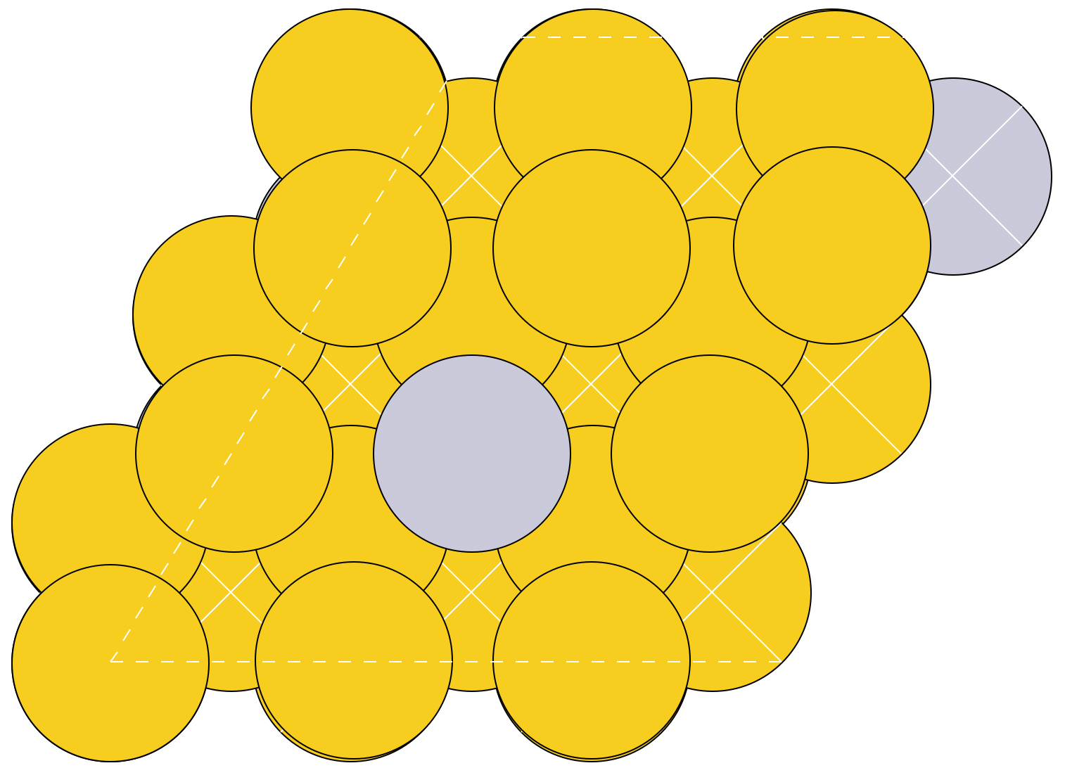
High-Entropy Alloys
Single-adsorbates
High-Entropy Alloys
Neighbouring adsorbates
*COOH + *H on all sites
*CO + *OH on all sites
*CO + *OH on best sites
Hollow-site
On-top
On-top
On-top
On-top
Slabs
Slabs
17 HEA slabs
6 sites/slabs
On-top
17 HEA slabs
17 HEA slabs
6 sites/slabs
100 HEA slabs
1 best site/slabs
100 HEA slabs
5 pure metals
5 pure metals
5 pure metals
5 pure metals
Single-site structures
Single and neighbouring adsorbates
*H
*COOH
*H + *COOH
B
B
Hollow-site
On-top
Hollow-site
On-top
Slabs
B
A
B
20 slabs/combination
120 total
20 slabs/combination
120 total
20 slabs/combination
120 total
20 slabs/combination
120 total
B
B
Swim ring structure
A: Pt, Pd
B: Ag, Au
Combinations:
PtAu, PtAg, PtAuAg, PdAu, PdAg, PdAuAg

